Slide 1
POM of capillaries, trails and spin-coated films, and Mobilities for Spincoated Films
How Poly(3-hexylthiophene) Aggregation Methods and Nanofiber Length Impact Liquid Crystallinity, Solid-State Alignment and Charge Carrier Mobility

Slide 2


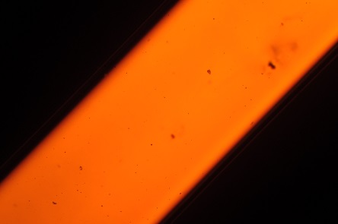
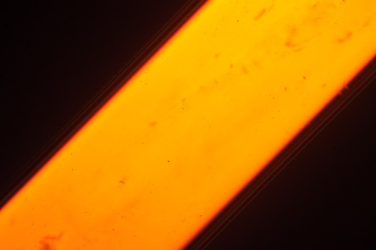
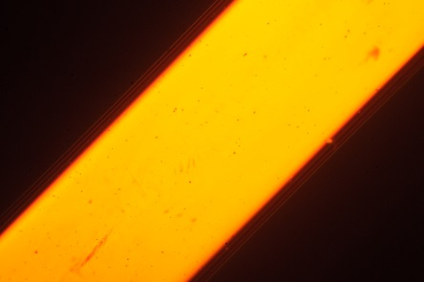
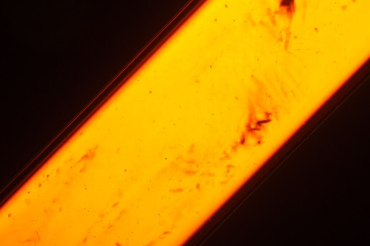


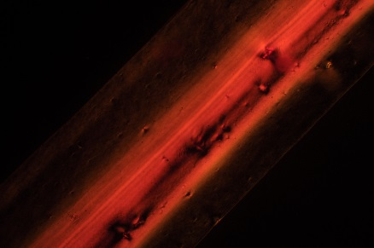
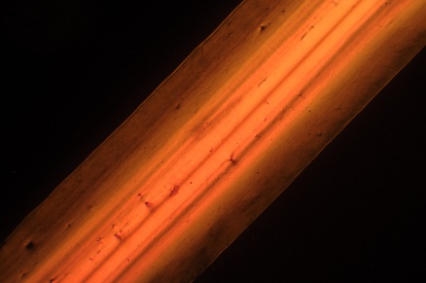
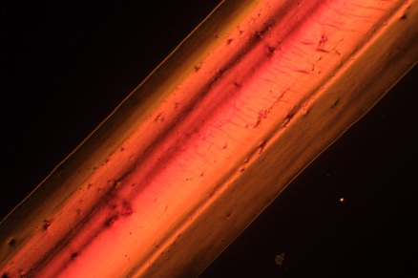
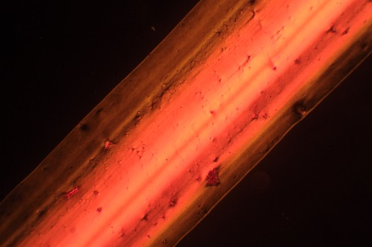
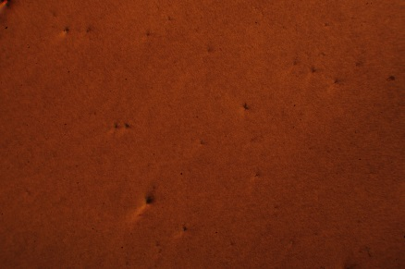
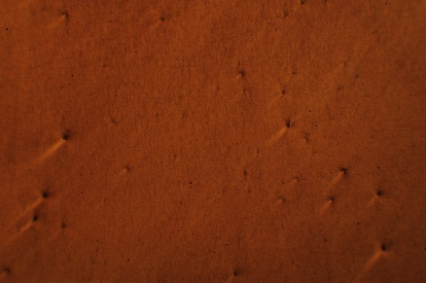
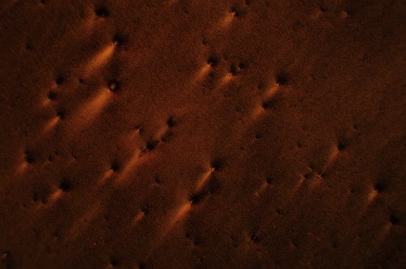
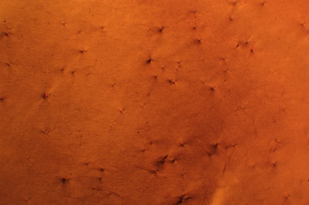
0 hr
12 hr
18 hr
24 hr
48 hr
96 hr
Solution
Drawn Film
Spincoated

Slide 3


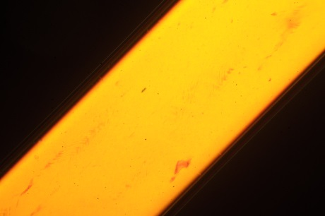


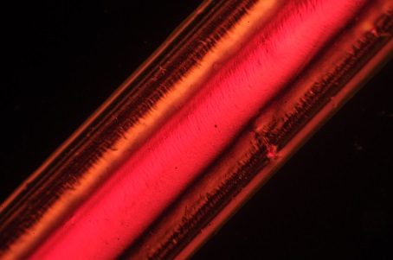
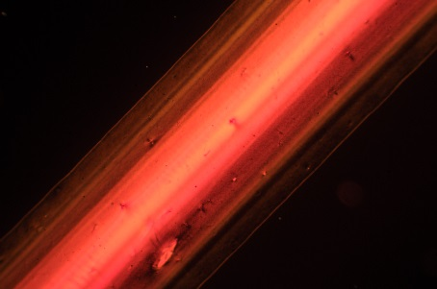
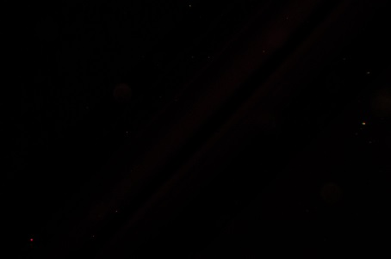

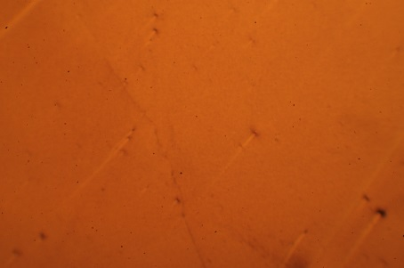
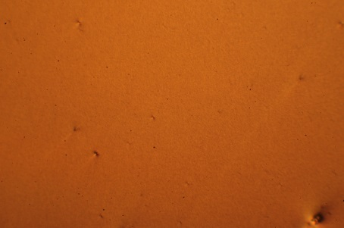
Sonicated 2 min then aged 96 hr
Sonicated 2 min then aged 192 hr
Aged 96 hr then sonicated 2 min
Sonicated 2 min*
Solution
Drawn Film
Spincoated

Slide 4
Other data I’m putting together
Mobilities of horizontal trails and mobilities of vertical trails
UV-Vis, Percent aggregation, exciton bandwidth of both films and solutions
AFM of drawn trails and spincoated films (Dalsu is doing these). I think the AFM data is key, because it will show the nanofiber length and orientation. Might help us make sense of things.
GIWAXS (Gang is taking these)
Linear dichroism (I will quantitatively obtain an order parameter using the images I obtained using a single polarizer for solutions, trails and spincoated films
Raman spectroscopy on trails (just have to make the plots, but the data shows there is anisotropy as we saw before)

Slide 5
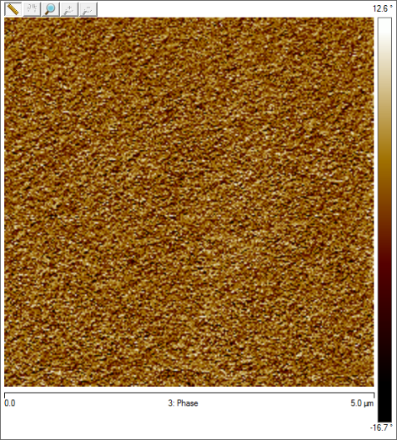



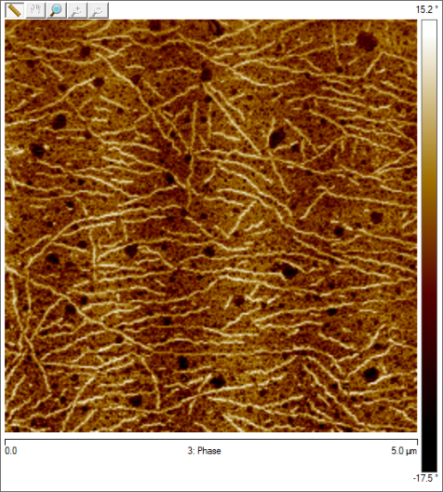
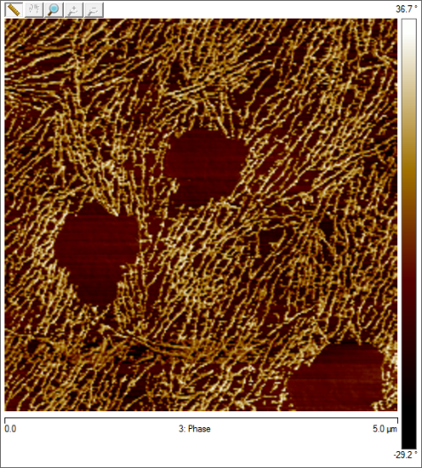
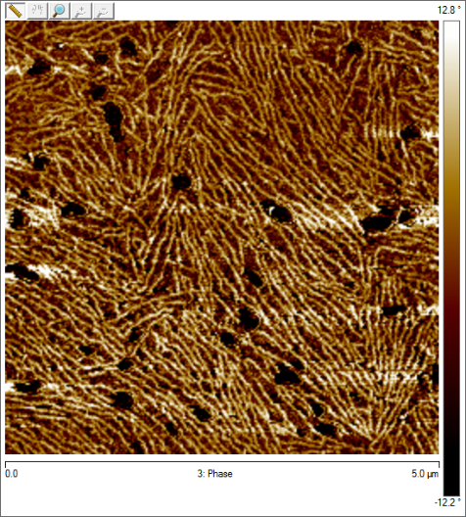
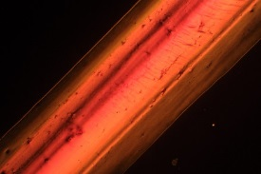
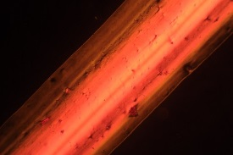

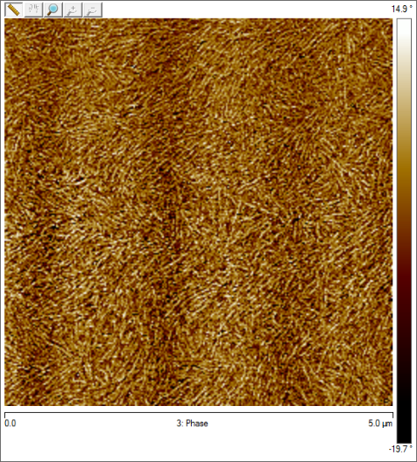
Is there a cleaner spot?
0 hr
12 hr
18 hr
Drawn Trails
96 hr
X
24 hr
48 hr
Need 96 hr Drawn AFM
Is there a cleaner spot?

Slide 6


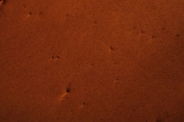

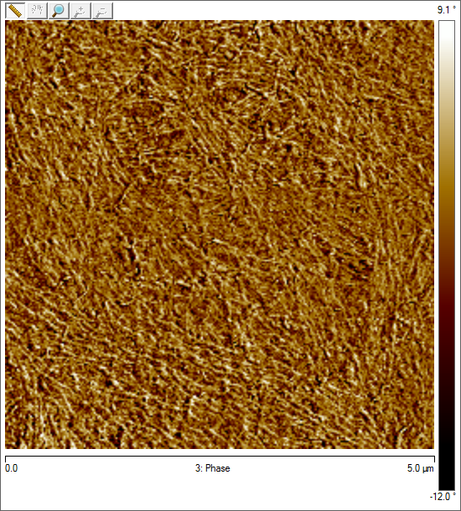
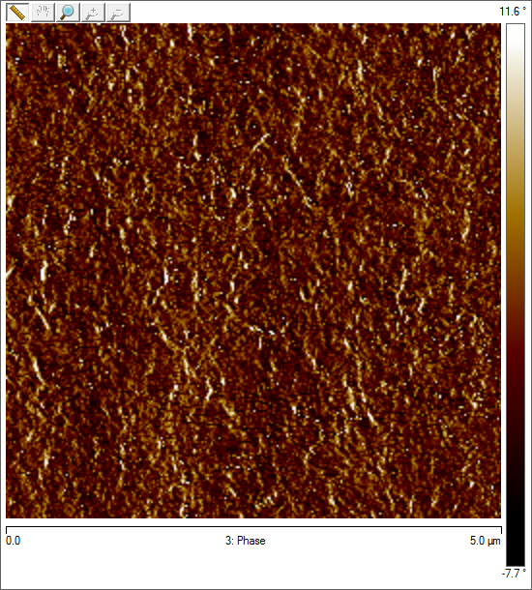

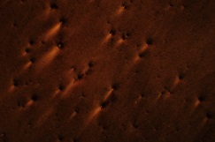
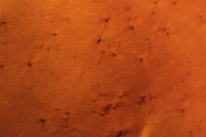
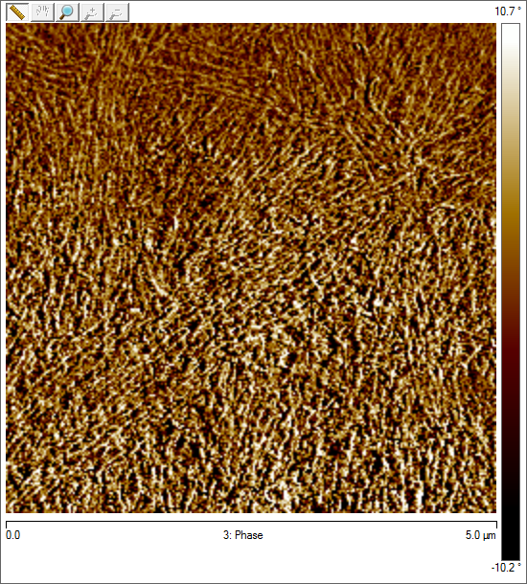
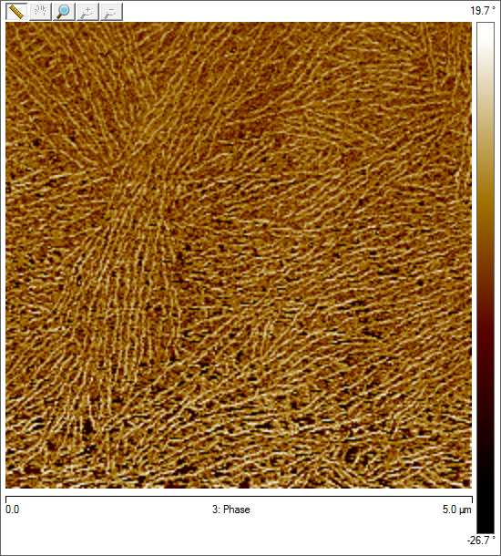
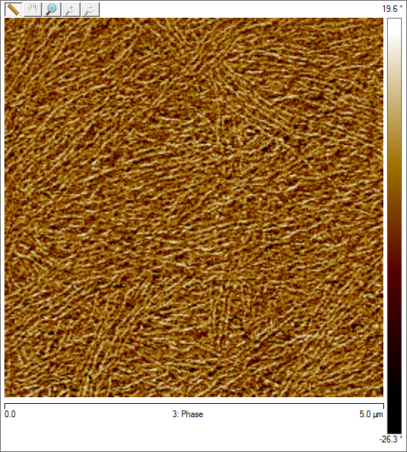
Any clearer?
X
0 hr
12 hr
18 hr
Spincoated
X
24 hr
48 hr
96 hr

Slide 7
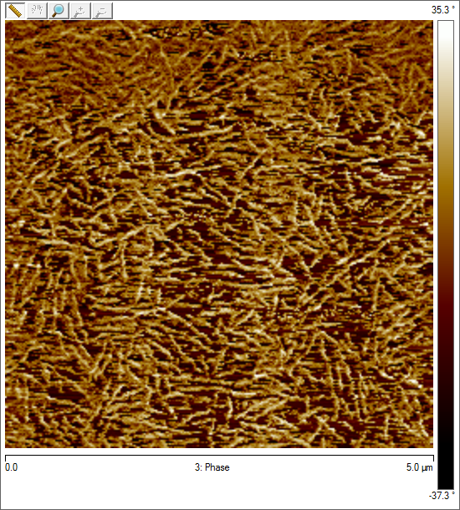
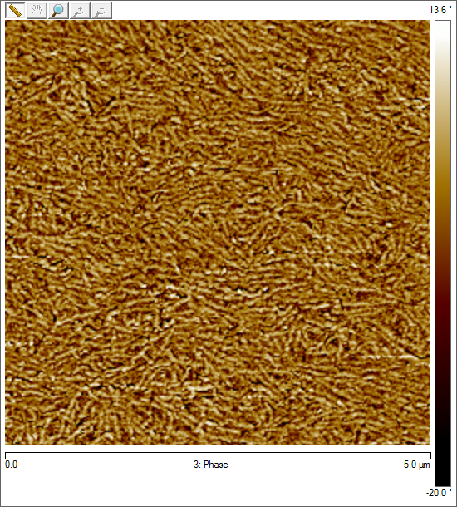
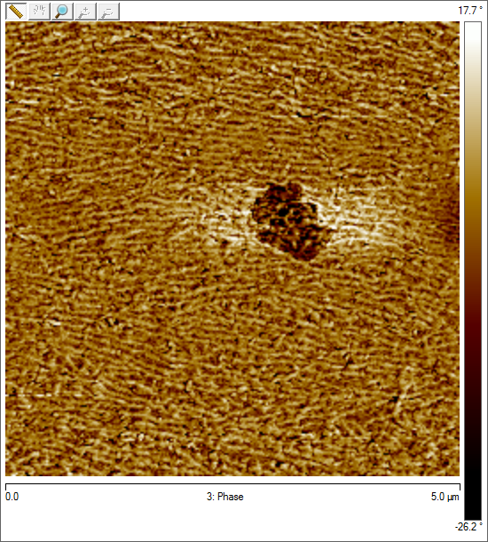
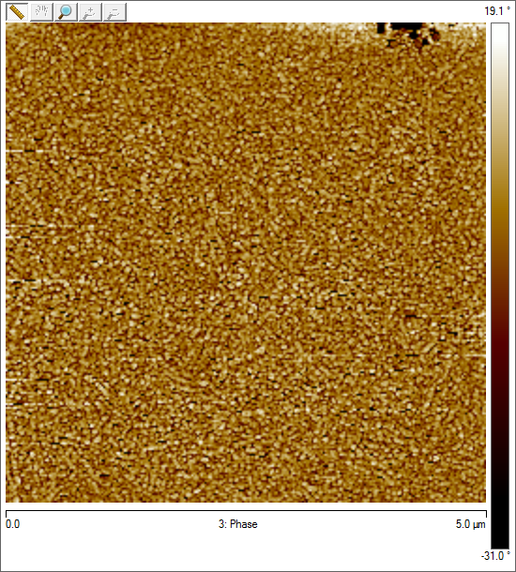
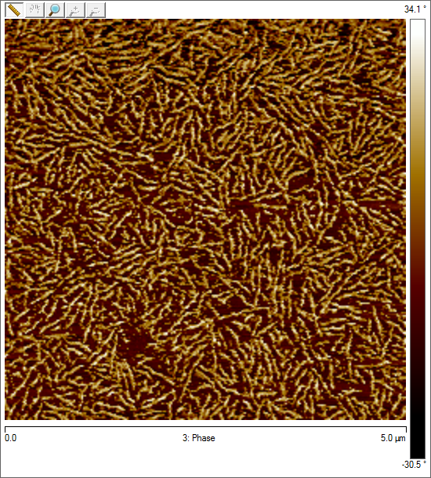
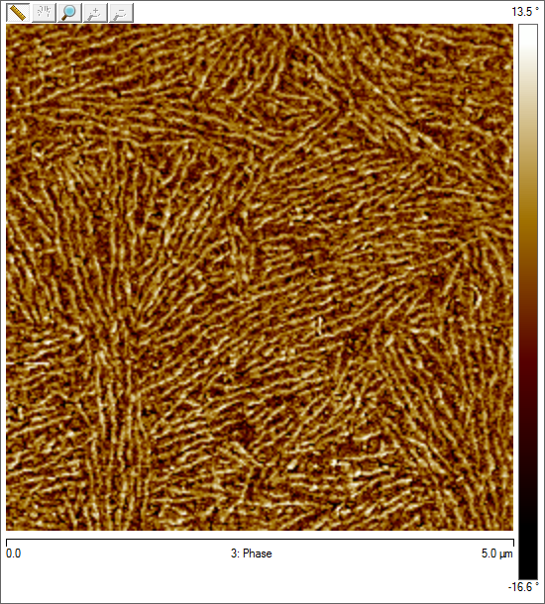
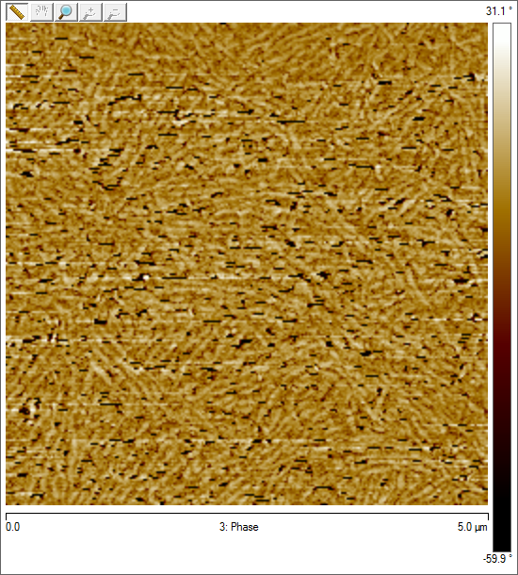
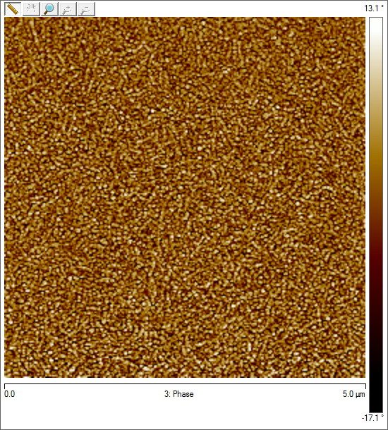
Drawn
Is there a cleaner spot?
Sonic 2 min
Sonic 2 min then 96 hr age
Sonic 2 min then 192 hr age
96 hr aged then 2 min sonic
Spincoated
X
Sonic 2 min
Sonic 2 min then 96 hr age
Sonic 2 min then 192 hr age
96 hr aged then 2 min sonic

Slide 8
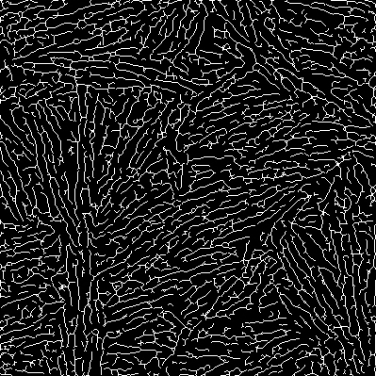
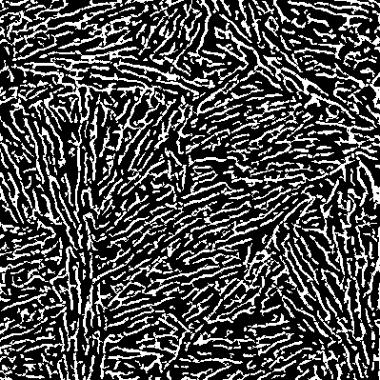
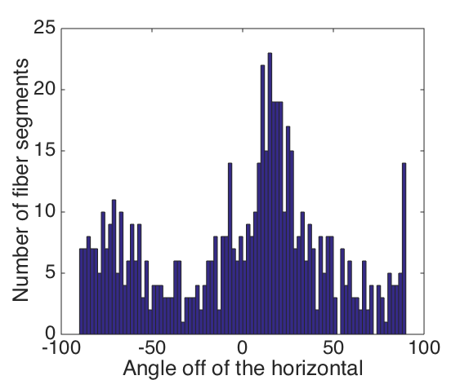
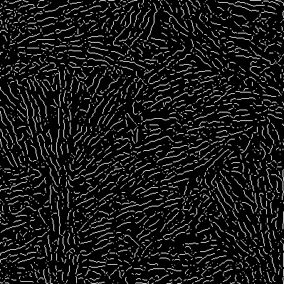
Sonic 2 min then 96 hr age
Segmentation
Skeletonization
So this shows overall orientational order – clearly there’s a huge peak at ~20 degrees, and smaller peaks at -90 and -70. I still haven’t figured out a good way to quantify local bundling without just showing those colored images…
Remove junctions
Analyze orientations
- only for segments with more than 7 pixels

Slide 9
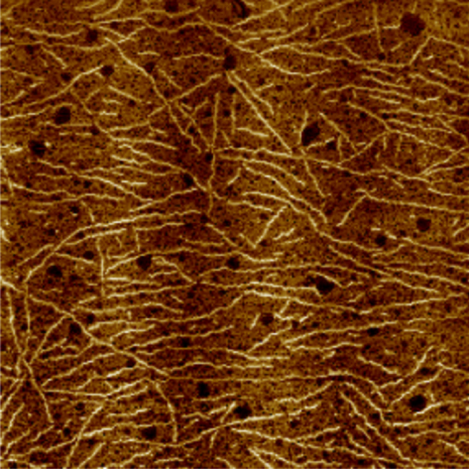
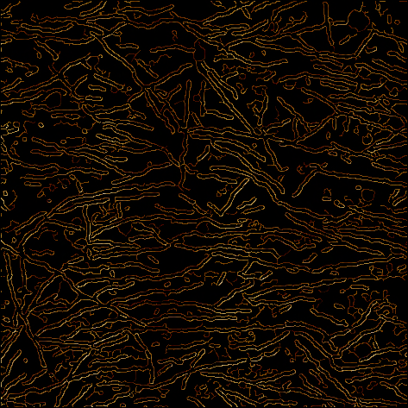
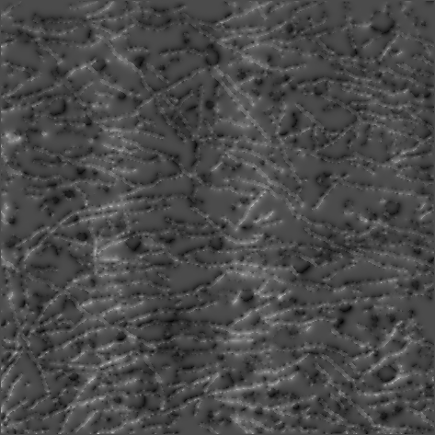
Raw Image
Intensities at Edges
Threshold Surface
Canny edge detection
Surface Interpolation

Slide 10
